Slide 1
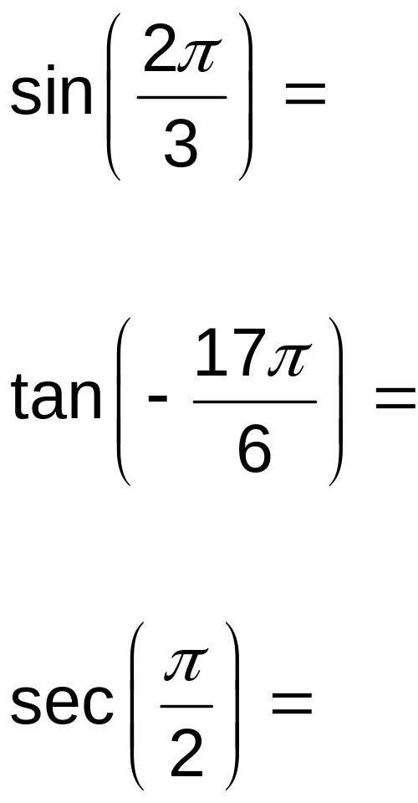
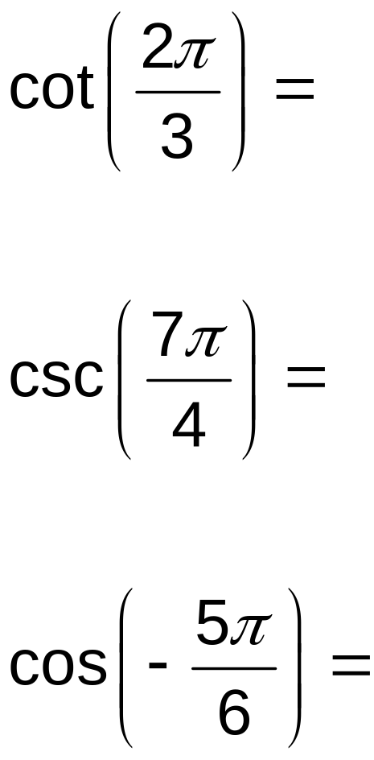
Find the exact values:

Slide 2
Write Equation from Graph

Slide 3
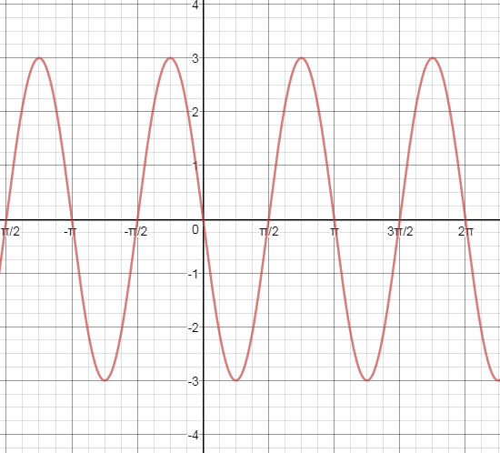
Find the Equation

Slide 4
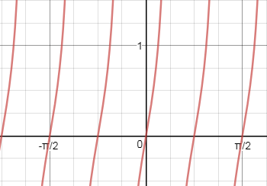
Tangent?

Slide 5
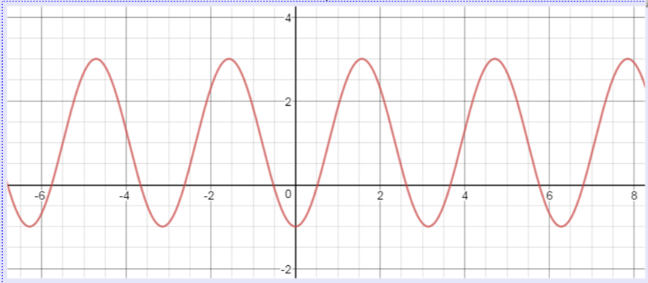

Slide 6
Odd and Even Trig Functions

Slide 7
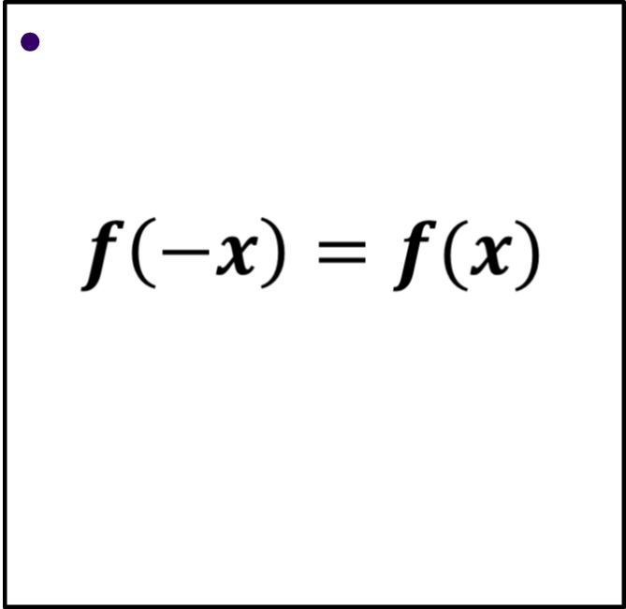
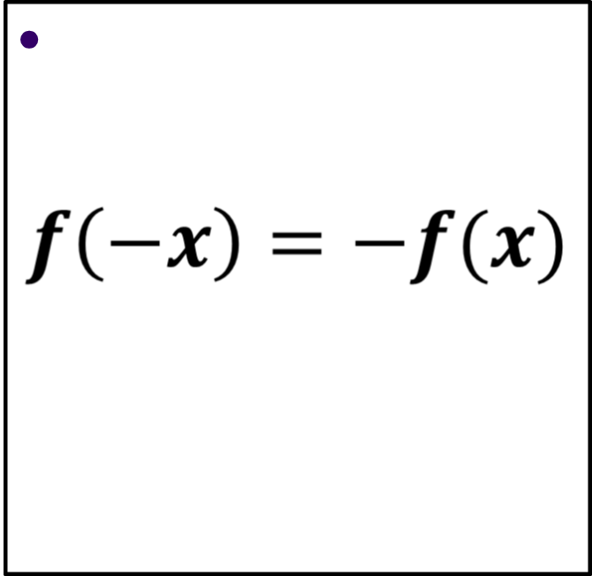
Reminder
EVEN
ODD

Slide 8
Go to Desmos.com and Explore!

Slide 9
Inverse Trig Functions

Slide 10
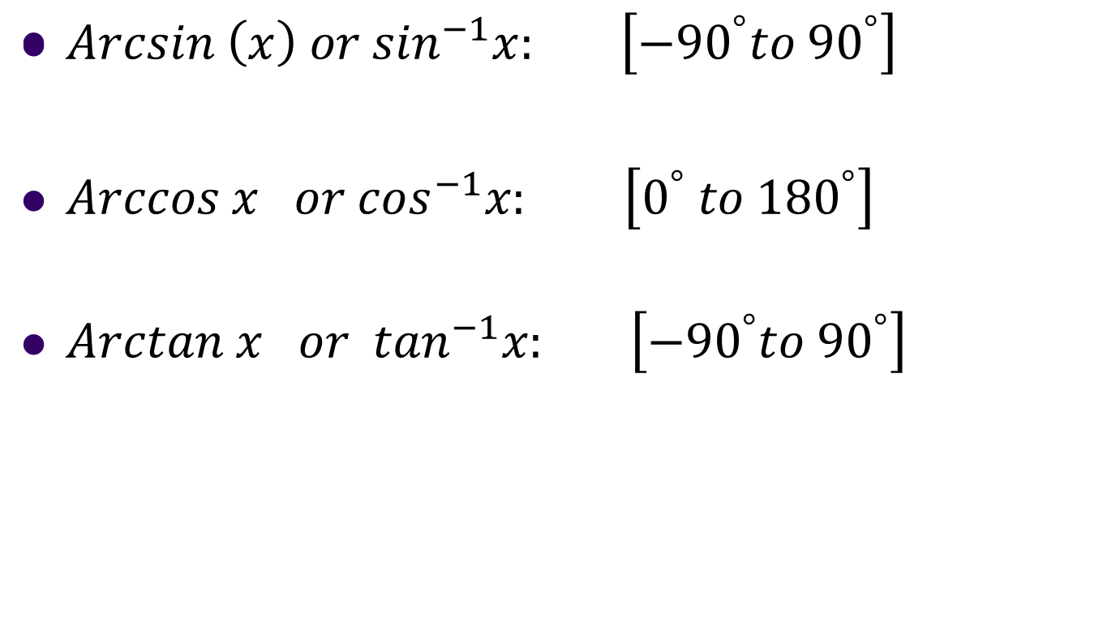
Inverse: “the angle whose (trig function) is x”
I wonder why the above inverses are limited
to the different domains above……let’s explore.

Slide 11
Let’s Talk About Inverses!
Recall that for a function to have an INVERSE function, it must be one-to-one.
In other words, it must pass the Horizontal Line Test.
Let’s see why Inverse Sine has a restricted domain…….

Slide 12
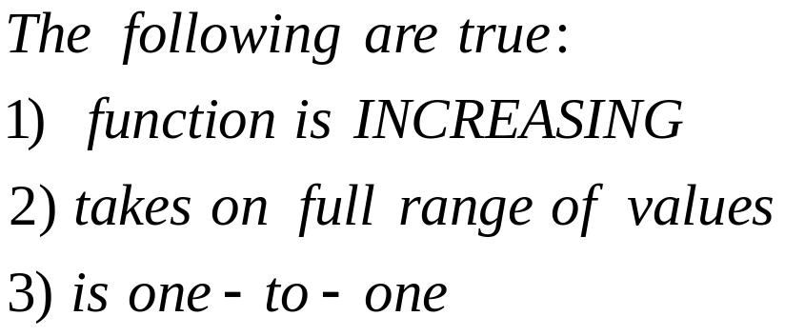
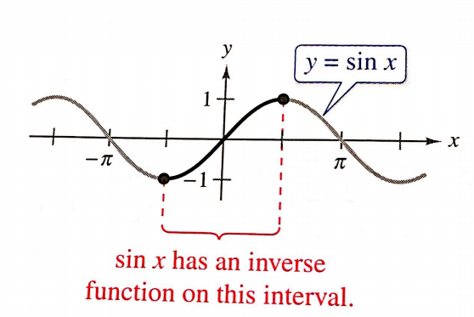
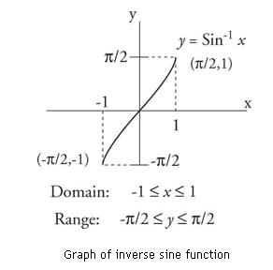
Sine
Q1 and Q4

Slide 13
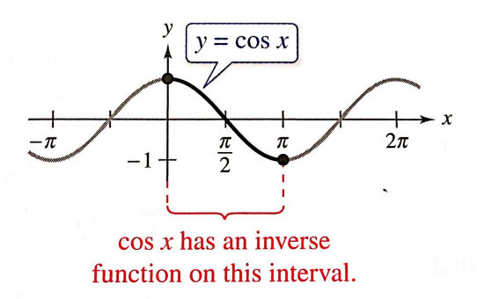
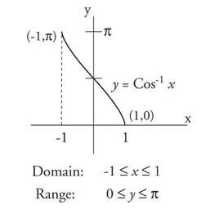
What About Cosine?
Q1 and Q2

Slide 14
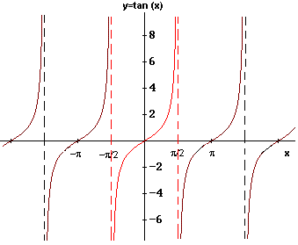

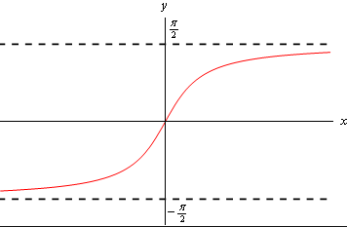


What About Tangent?
Q1 and Q4

Slide 15
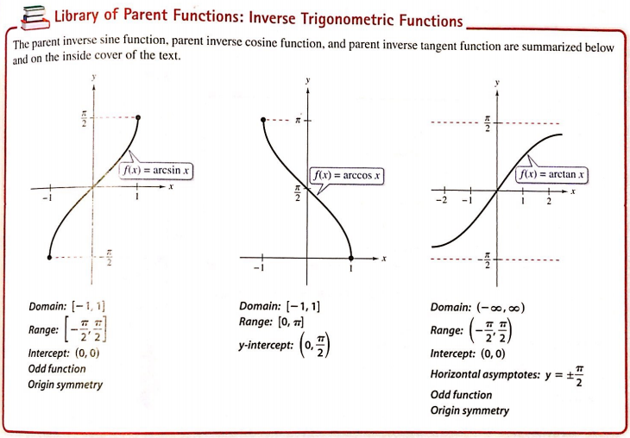
Sin, Cos, Tan - Inverses

Slide 16
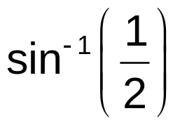
When evaluating the inverse sine function, it helps to remember the phrase “the arcsine of x is the angle (or number) whose sine is x.”
The angle you are looking for MUST give a
POSITIVE answer for sine. Therefore, we must
be in Quadrant I.
+
-

Slide 17
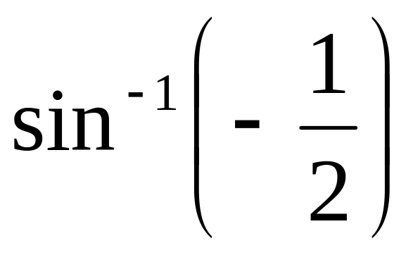
Evaluate

Slide 18
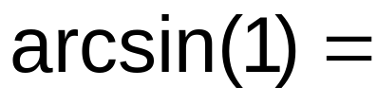
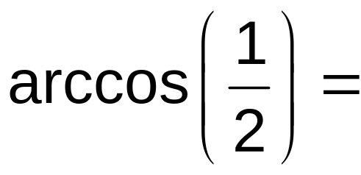
Evaluate:
+
-
-
+

Slide 19
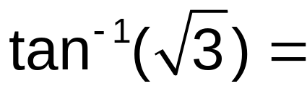
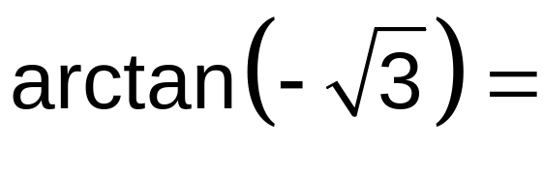
Evaluate:
+
-

Slide 20
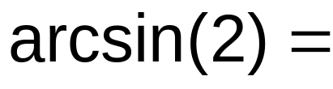
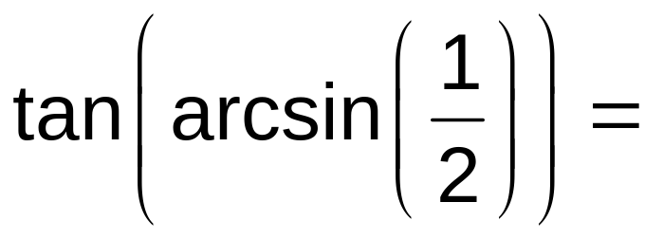
Evaluate:

Slide 21
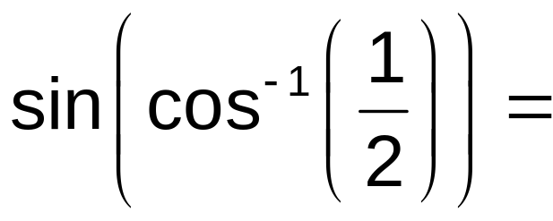
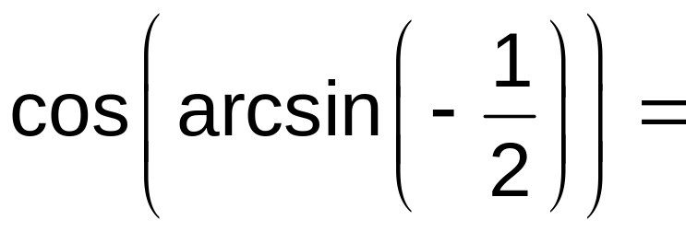
Evaluate:

Slide 22
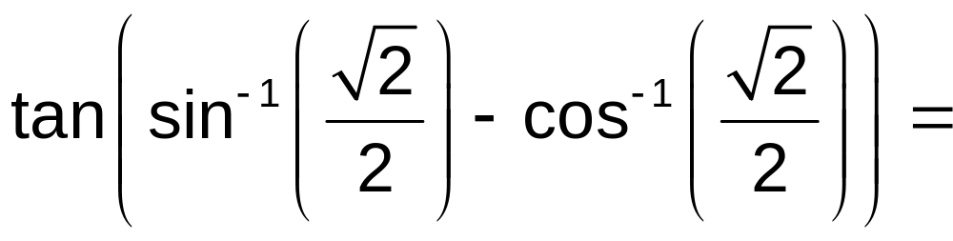
Evaluate:

Slide 23
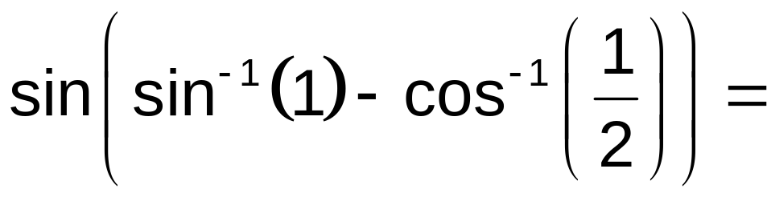
Evaluate:

Slide 24
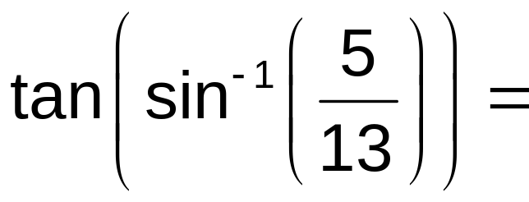

Evaluate:
Not on the Unit Circle – MUST DRAW!
13
5
12

Slide 25
Homework
Inverse Trig worksheet

